Slide 1
CS4298 Business Pitch.

Slide 2
1.
About Us
Who we are?
Our motivation.

Slide 3
Hello!
We are :
SRIDHAR Prashant (54565839)
LUIS Diego (40096210)

Slide 4

HORAMA
Horama is a Machine Learning firm where we intend to make ML accessible to everyone.
This is our first product also titled ‘Horama’.
The Horama app is an iOS application that is an Image Classifier built on top of Apple’s CoreML. However unlike some of our competitors, we possess a huge edge.

Slide 5

Where are we from and where are we located?
Diego
(Swiss)
our office
Prashant
(India)

Slide 6
Machine Learning
What is Machine Learning?
Why is it important?

Slide 7
After all, this is what learning is: as we learn a task, we get better at it, be it tennis, geometry, or a foreign language.
Ethem Alpaydin

Slide 8
A Brief idea about Machine Learning
Machine Learning is a field of Computer Science that uses the power of statistics to give Computers the ability to ‘learn’ with data without being explicitly programmed.
Over the years, Machine learning has developed many significant applications in the fields of :
Financial Trading
Transportation
Marketing and Sales
HealthCare
Oil and Gas

Slide 9

How do we use Machine Learning?
Our usage of ML is predominantly in the field of Image Recognition.
Image Recognition is giving the computer the ability to ‘see’, decipher and understand the information fed to it by means of an image.
Coffee-Cup

Slide 10
Image Classification
How does it work?

Slide 11
There are 6 main steps involved
Gathering training data
In-order for our Machine Learning Model to work efficiently. We need to train it, this is done by adding more images containing objects into our dataset.
Preprocessing
Preprocessing is mainly done to make sure that small anomalies like duplicate images or distorted images do not exist in the dataset we use to train our ML model.
Feature Extraction
Feature extraction involves reducing the amount of resources required to describe a large set of data.
Choosing a ML model
Choosing a machine learning algorithm which in our case is a Support Vector Machine(SVM) Model.
Parameter Training
Making sure that the feature we will primarily be focusing on for classification is appropriate and continue to train the model based on that parameter
Trial and error
Keep checking whether the model offers the correct result based on which you can determine whether you need to add more data for further training.

Slide 12
Place your screenshot here
Demonstration
Here is a simple demo of what our application is capable of.

Slide 13
Business Model

Slide 14
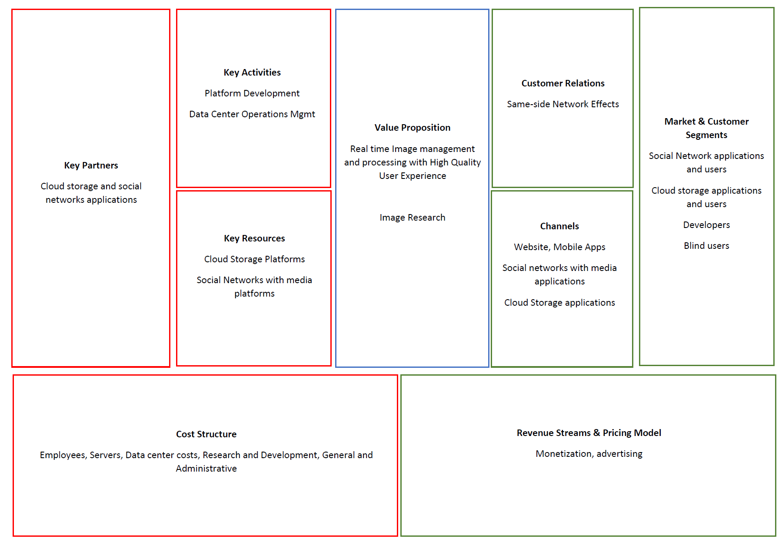

Slide 15
Future Plans

Slide 16
This is our brief future plan
Look for specific objects in complex images
Collaborate with other tech companies in ways where they can utilise our app
We intend to implement a live object tracker

Slide 17
Thanks!
Any questions?

